Slide 1
modelling Root µHydraulics - MECHA
Valentin Couvreur
1

Slide 2
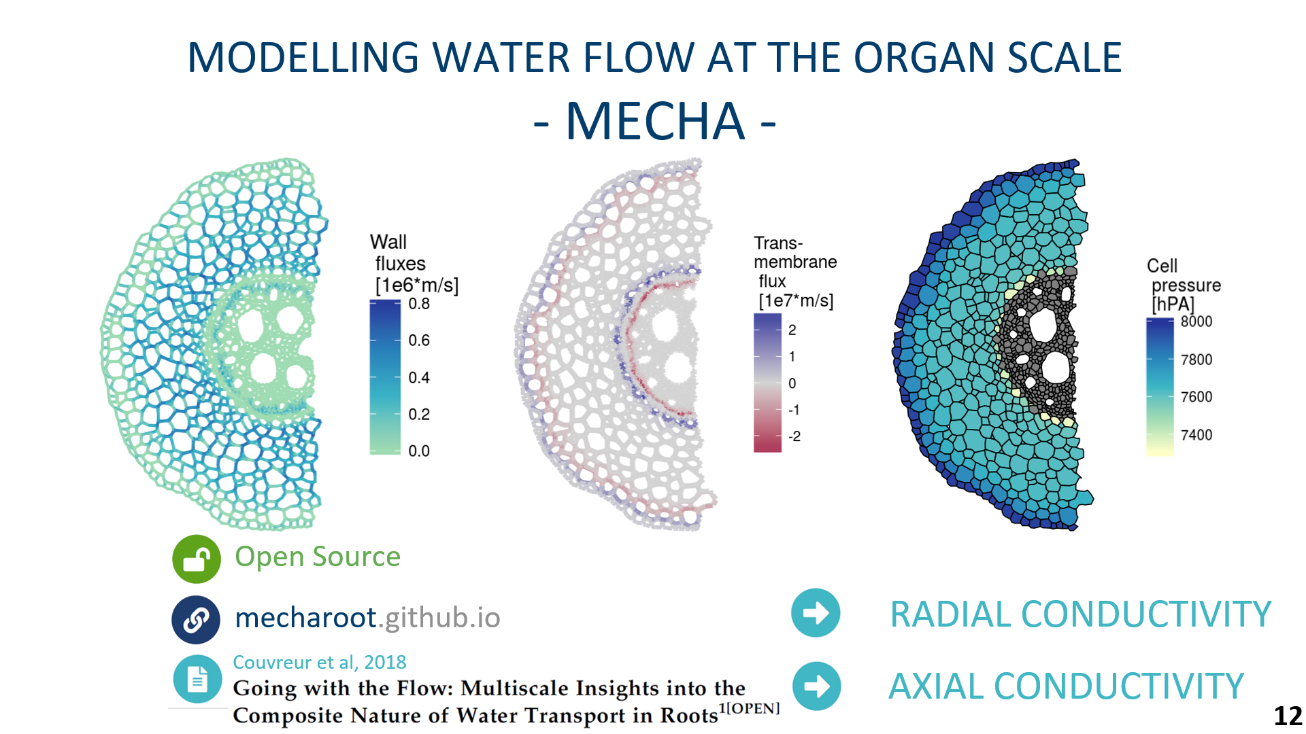
Couvreur V, Faget M, Lobet G, Javaux M, Chaumont F, Draye X, Going with the Flow: Multiscale Insights into the Composite Nature of Water Transport in Roots, Plant Physiology, Volume 178, Issue 4, December 2018, Pages 1689–1703, https://doi.org/10.1104/pp.18.01006
- Modelling Root Anatomy & Hydraulics -
2

Slide 3
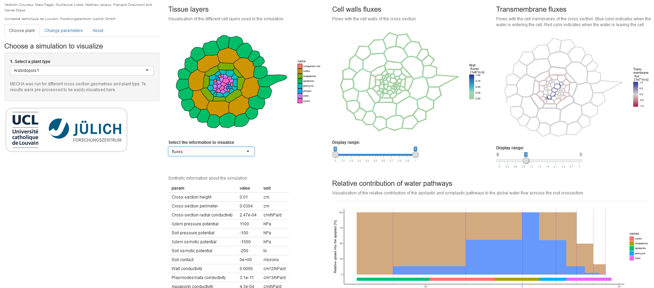
https://plantmodelling.shinyapps.io/mecha/
- Modelling Root Anatomy & Hydraulics -
3

Slide 4
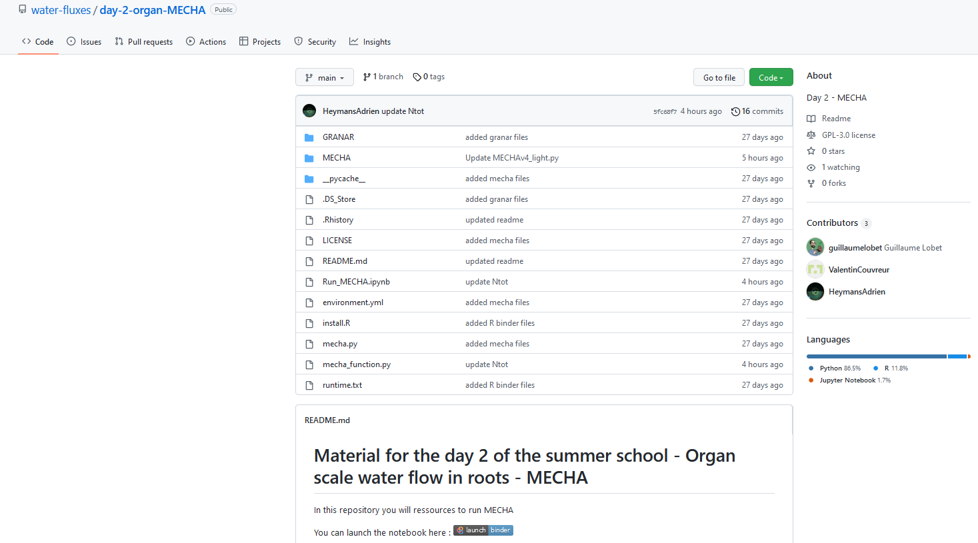
https://github.com/water-fluxes/day-2-organ-MECHA
Run MECHA via Binder
- Modelling Root Anatomy & Hydraulics -
4

Slide 5
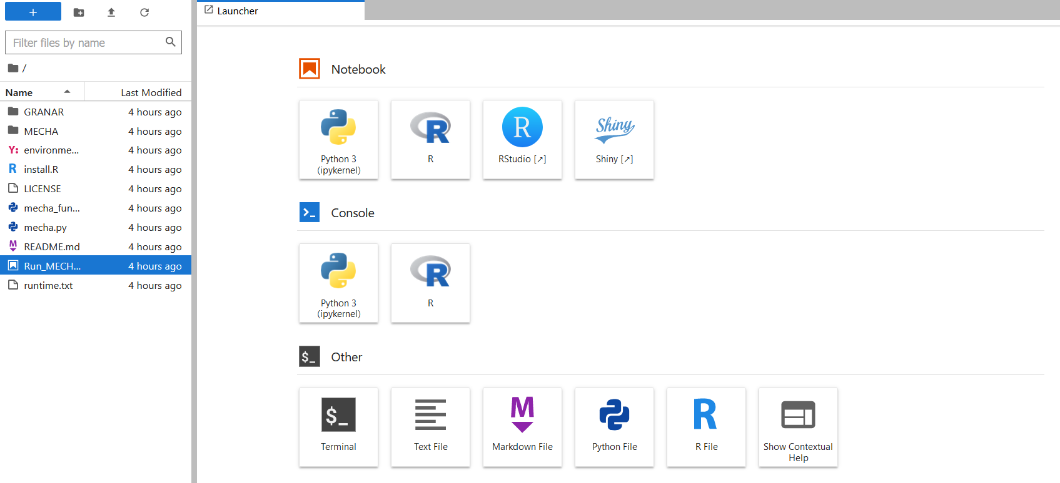
Once on Binder… let’s open the Jupyter Notebook!
Double click on Run_MECHA.ipybn
- Modelling Root Anatomy & Hydraulics -
5

Slide 6
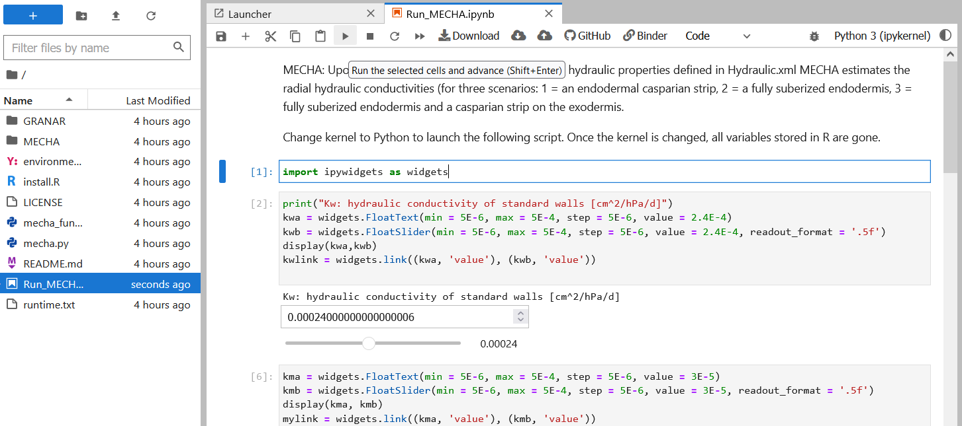
Once on Binder/Jupyter Notebook… let’s run MECHA!
2. Click on play
1. Click on a cell
3. Click on play
again to run the next cell
4. As a starter, run the script with default kwa and kma values. It’ll take a few min.
- Modelling Root Anatomy & Hydraulics -
6

Slide 7
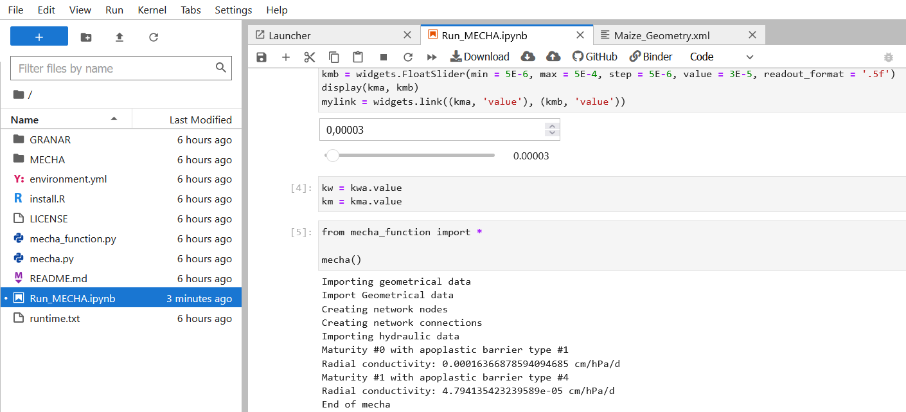
Once on Binder/Jupyter Notebook… let’s run MECHA!
1. k_{r} for root with Casp
2. k_{r} for suberised root
- Modelling Root Anatomy & Hydraulics -
7

Slide 8
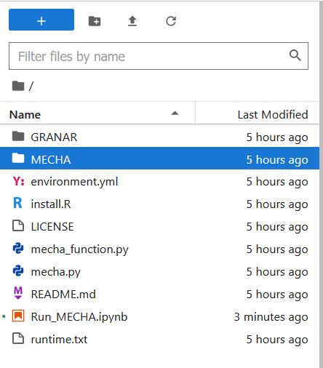
Once on Binder… let’s update the root anatomy!
Double click on folders MECHA/ then cellsetdata/
- Modelling Root Anatomy & Hydraulics -
8

Slide 9
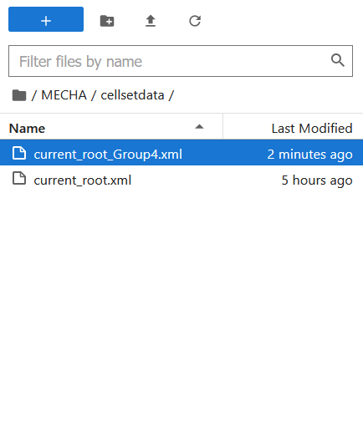
Once on Binder… let’s update the root anatomy!
Drag and drop your root anatomy from GRANAR
- Modelling Root Anatomy & Hydraulics -
9

Slide 10
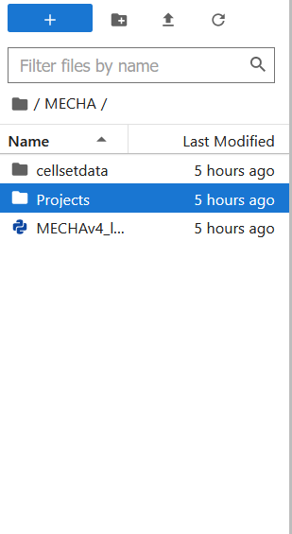
Once on Binder… let’s update the root anatomy!
Go to the folder MECHA/Projects/granar/in/
- Modelling Root Anatomy & Hydraulics -
10

Slide 11
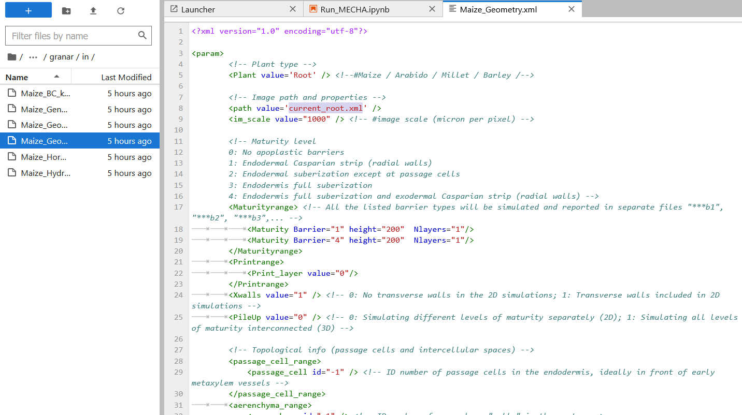
Once on Binder… let’s update the root anatomy!
3. Update the name of folder in which the new outputs will be stored
2. Update the name of the dragged GRANAR output, so it corresponds to your new root anatomy file name (e.g. ‘current_root_Group4.xml’)
1. Open the file ‘Maize_geometry.xml’
4. In Run_MECHA.ipynb, run the cell « from mecha_function … » and check new kr values
- Modelling Root Anatomy & Hydraulics -
11

Slide 12
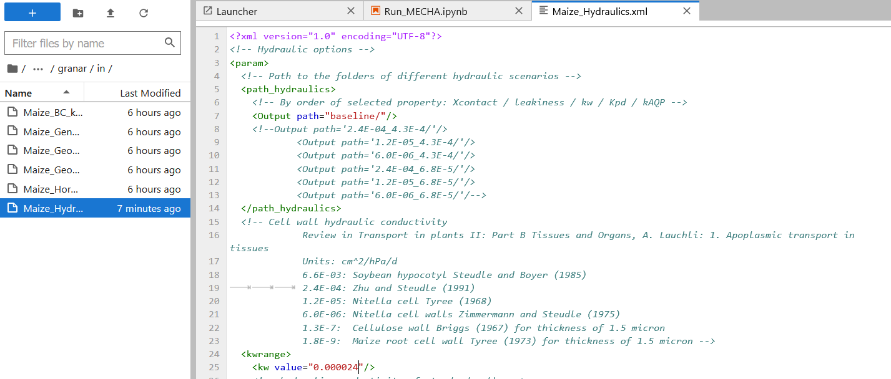
Once on Binder… let’s update the cell hydraulic properties!
3. Update the name of the scenario
1. Open the file ‘Maize_hydraulics.xml’
2. Update the hydraulic conductivity of cell walls (kw) or membranes aquaporins (kAQP), lower in the file
4. In Run_MECHA.ipynb, run the cell « from mecha_function … » and check new kr values
- Modelling Root Anatomy & Hydraulics -
12

Slide 13
EXERCISE
https://github.com/water-fluxes/day-2-organ-MECHA
Please send your GRANAR inputs / outputs and MECHA kr values for default cell hydraulic properties to guillaume.lobet@uclouvain.be so we could discuss and compare anatomies and conductivities ☺
- Modelling Root Anatomy & Hydraulics -
13

